Slide 1



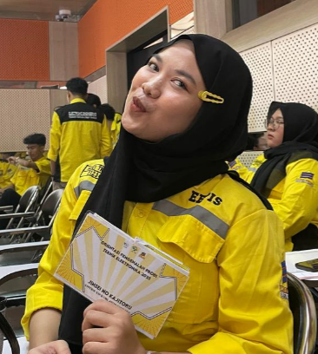
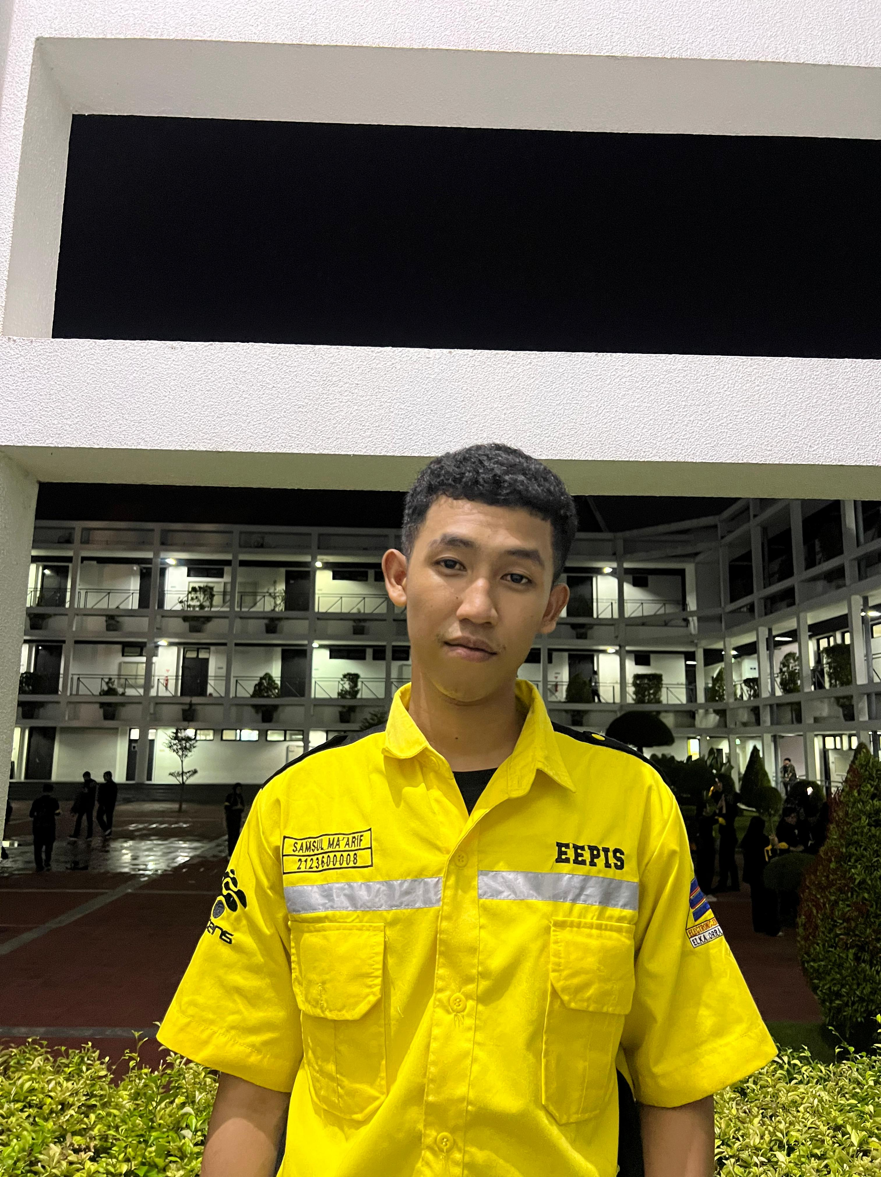
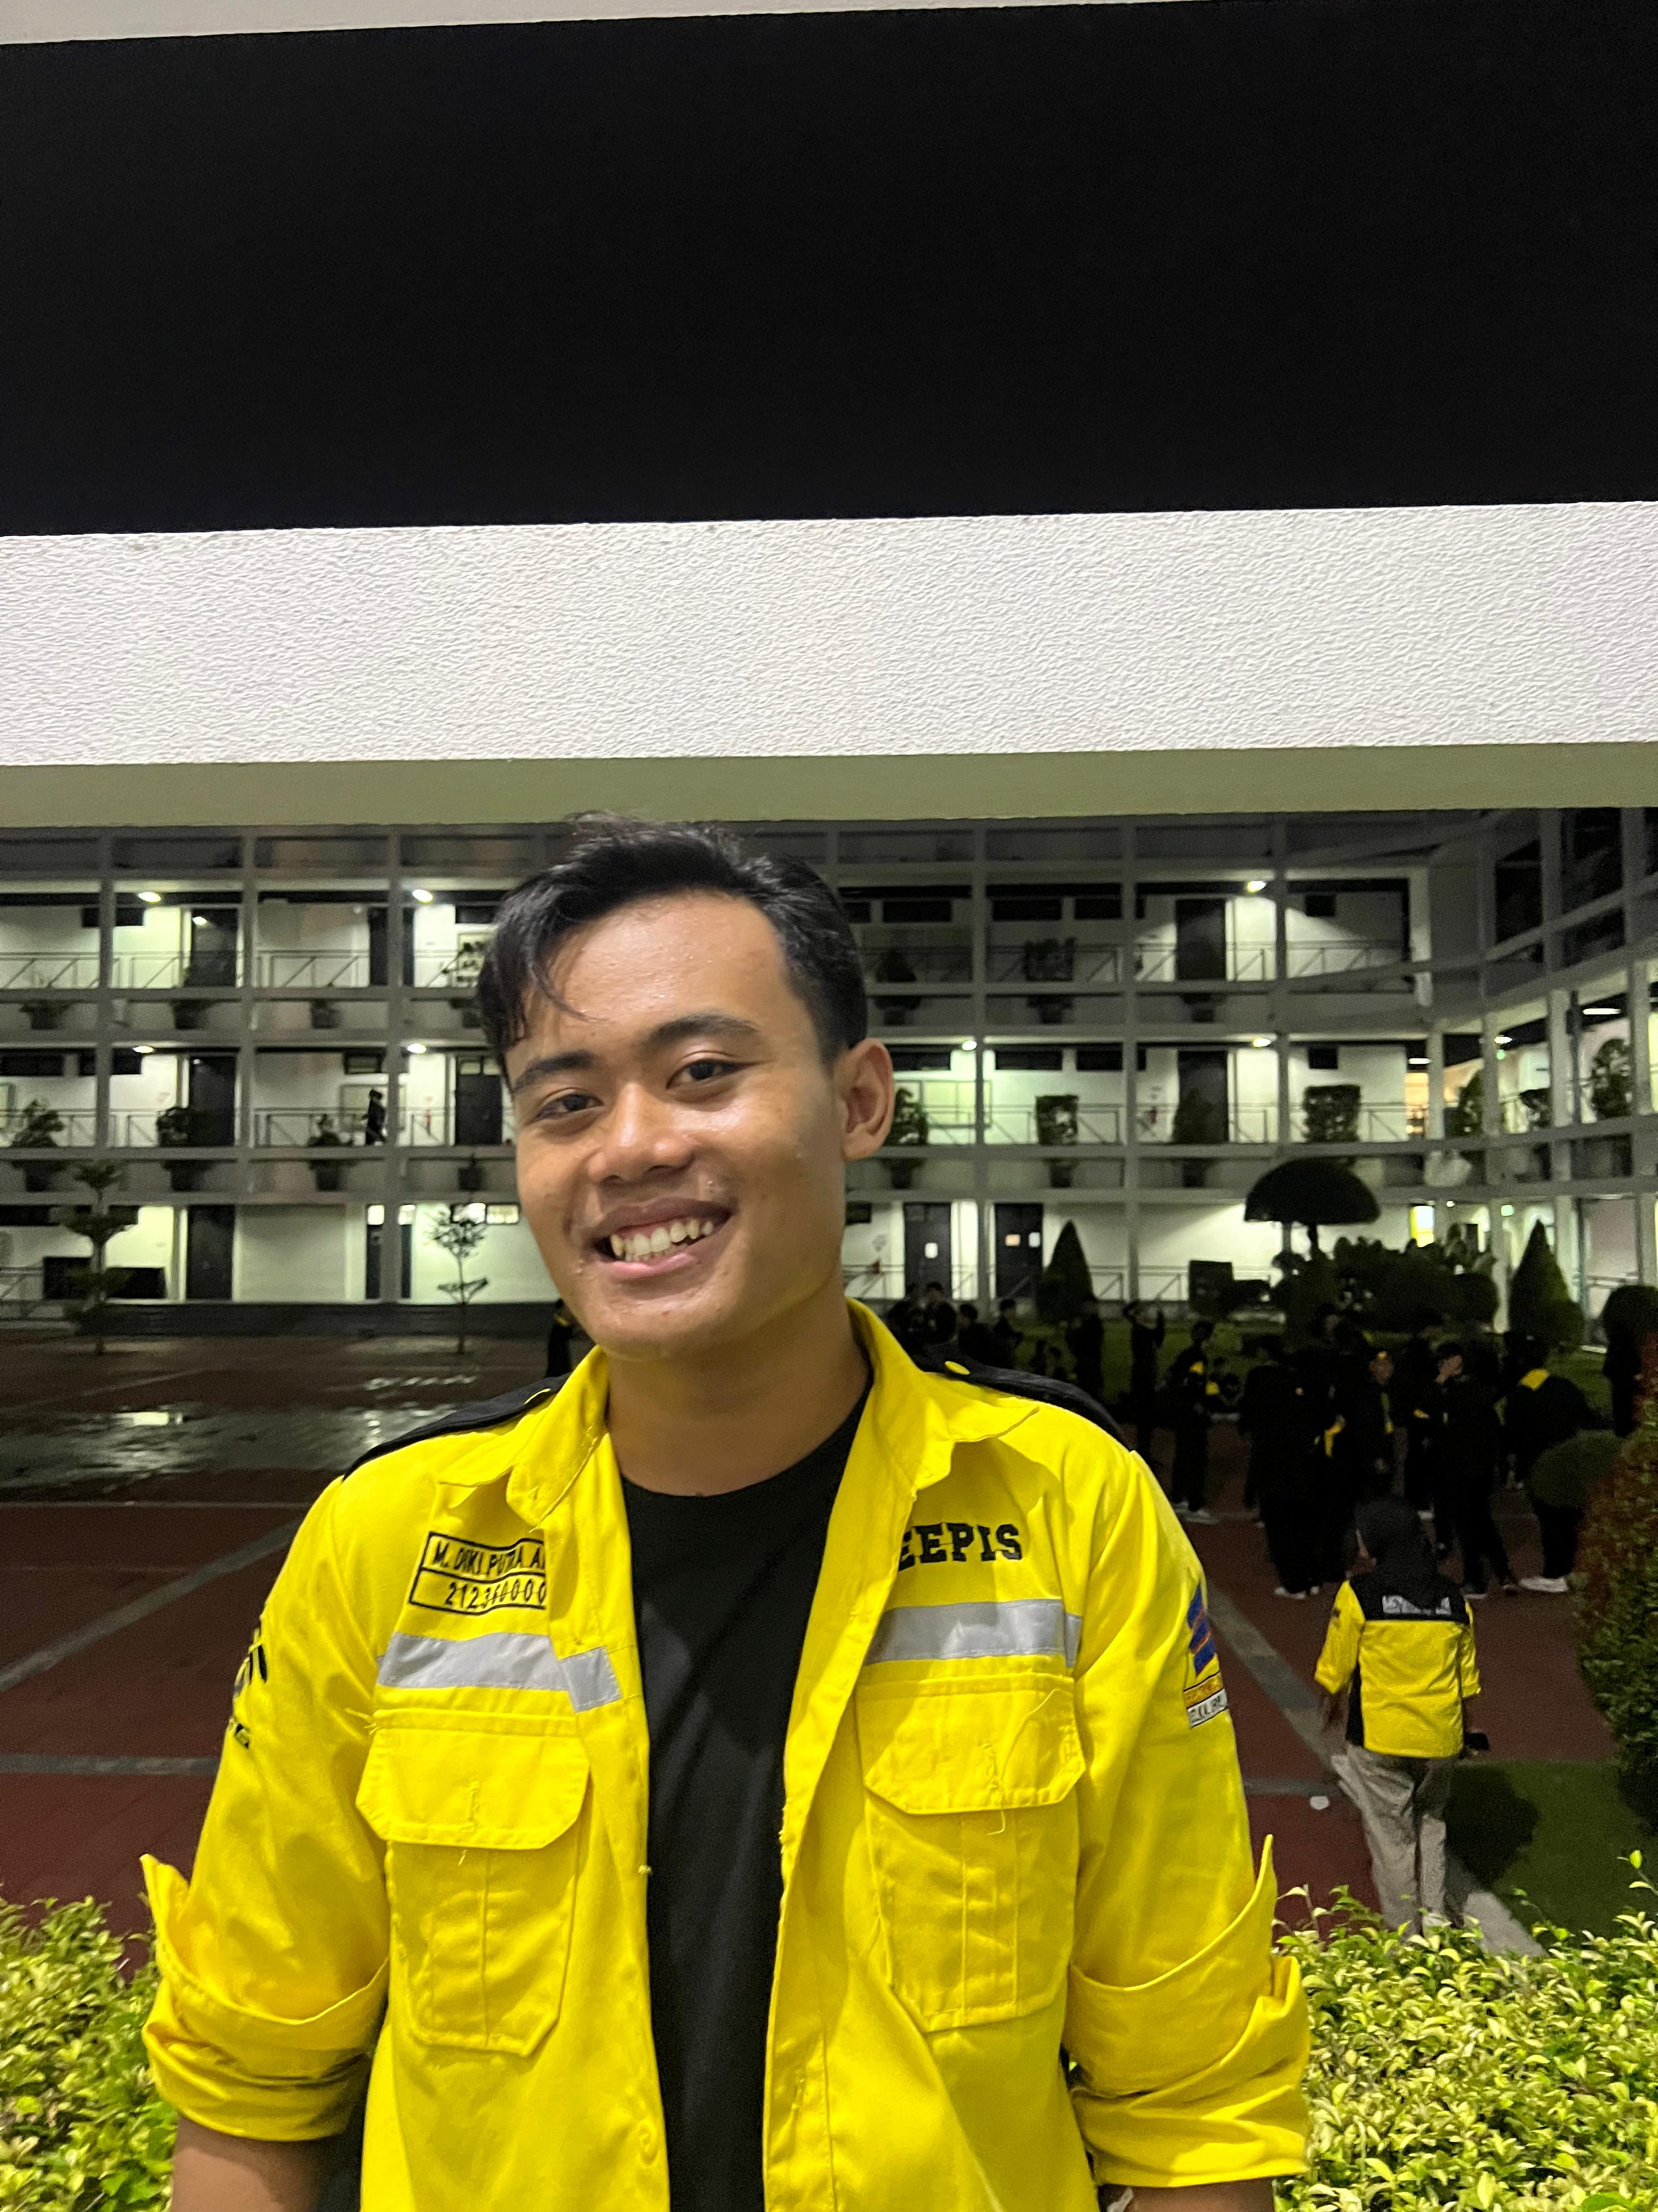
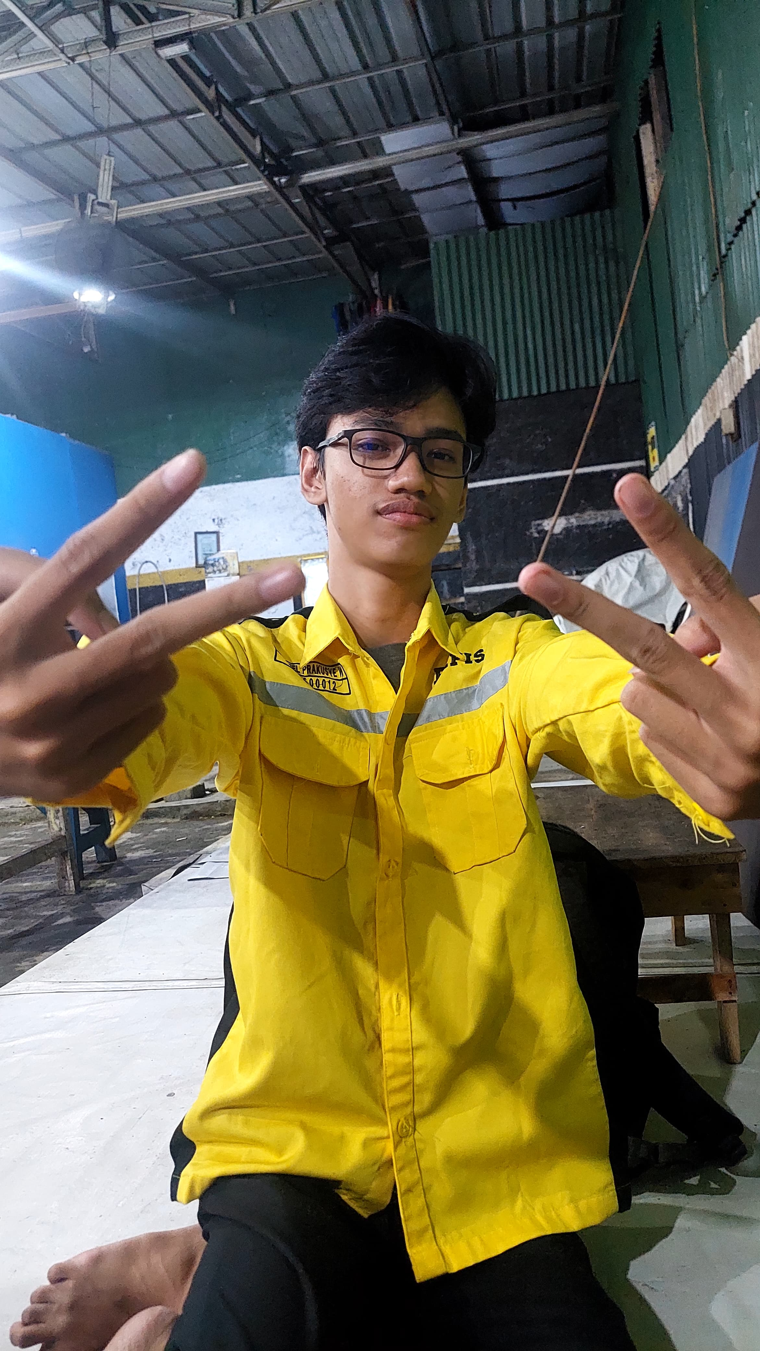
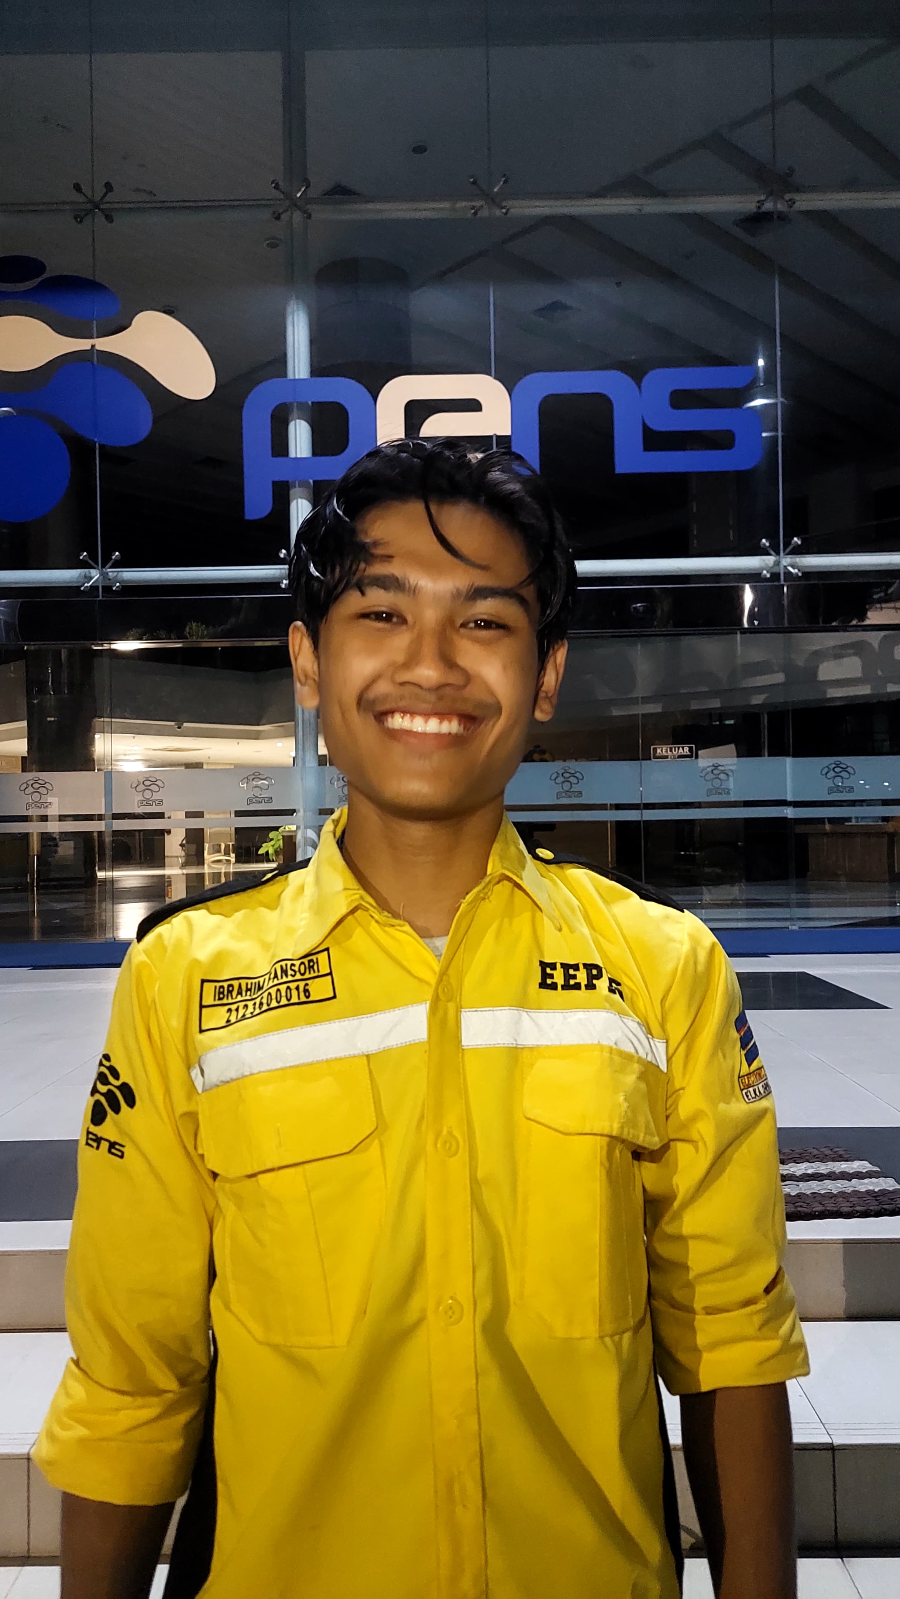
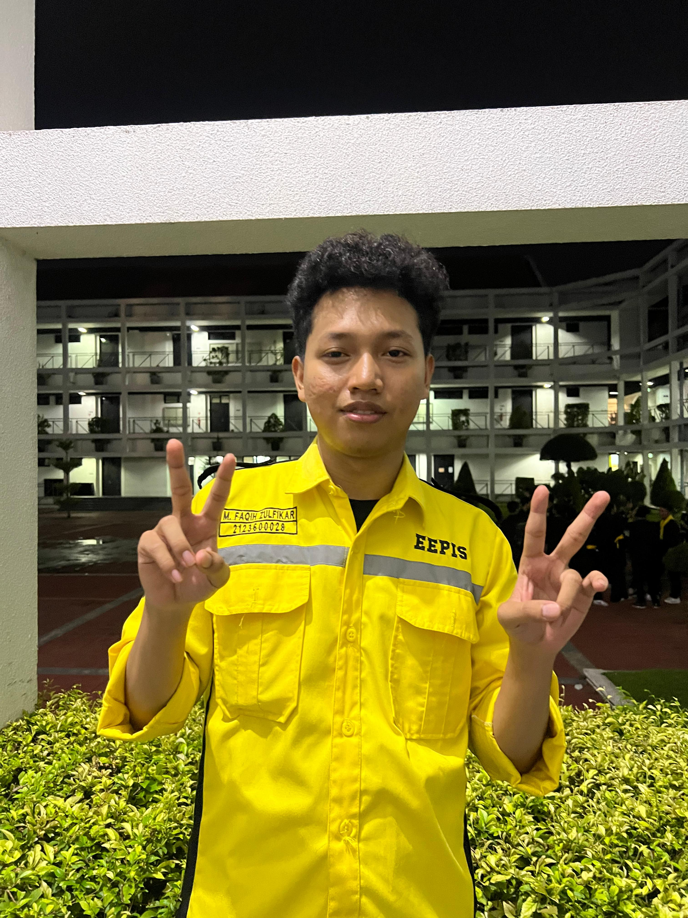
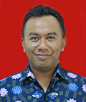
Smart Trolley for Efficient Checkout Utility
OUR STECU TEAM
Suci Tri Rahayu
2123600002
Samsul Ma'arif 2123600008
M. Diki Putra A. 2123600009
Project Mikrokontroller
M. Daniel P. 2123600012
Ibrahim Fansori 2123600016
M. Faqih Zulfikar 2123600028
2 D4 ELEKTRONIKA A
Dosen Pengampu
Akhmad Hendriawan ST, MT
197501272002121003
POLITEKNIK ELEKTRONIKA NEGERI SURABAYA

Slide 2
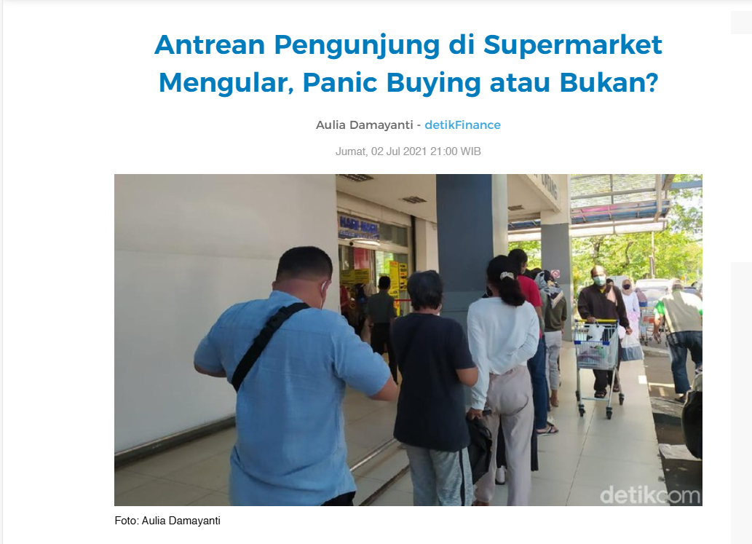
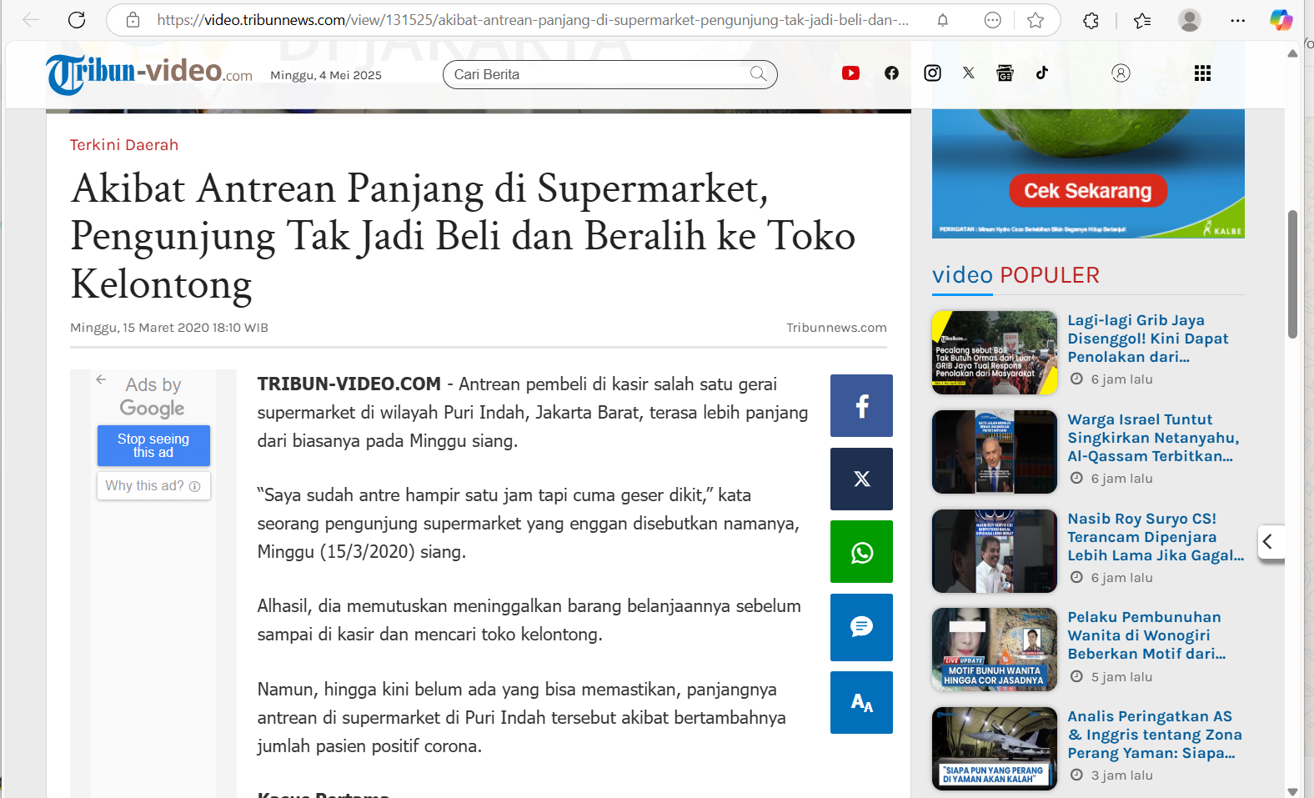
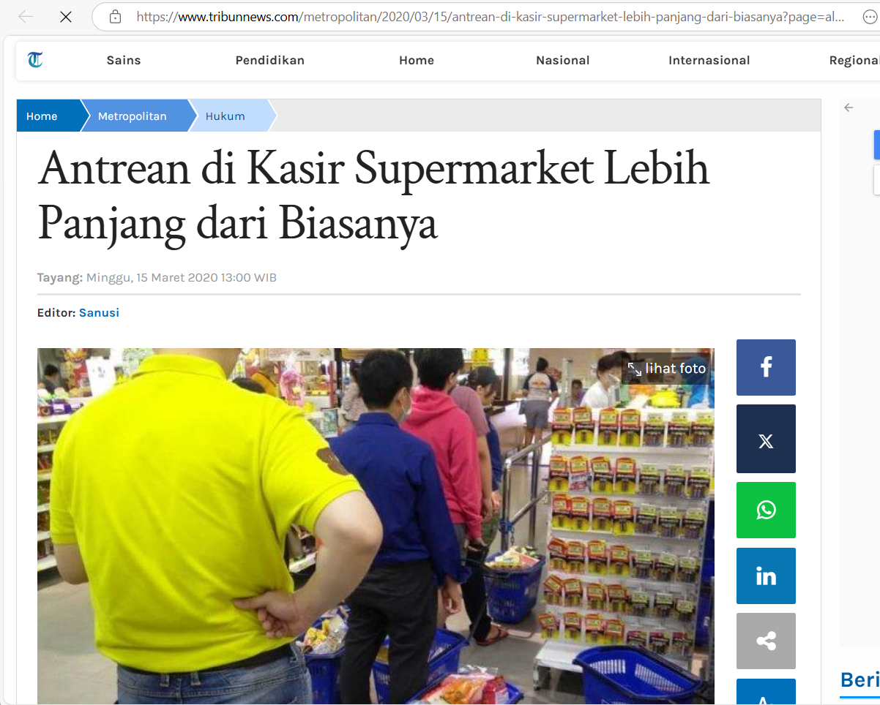
Latar Belakang

Slide 3
Alat & Bahan
04
Buzzer
05
Breadboard + Kabel Jumper
01
Arduino Mega 2560
06
Push Button
02
Layar OLED / LCD I2C 16x2
07
Power Supply
03
Modul Bluetooth HC-05 / HC-06

Slide 4
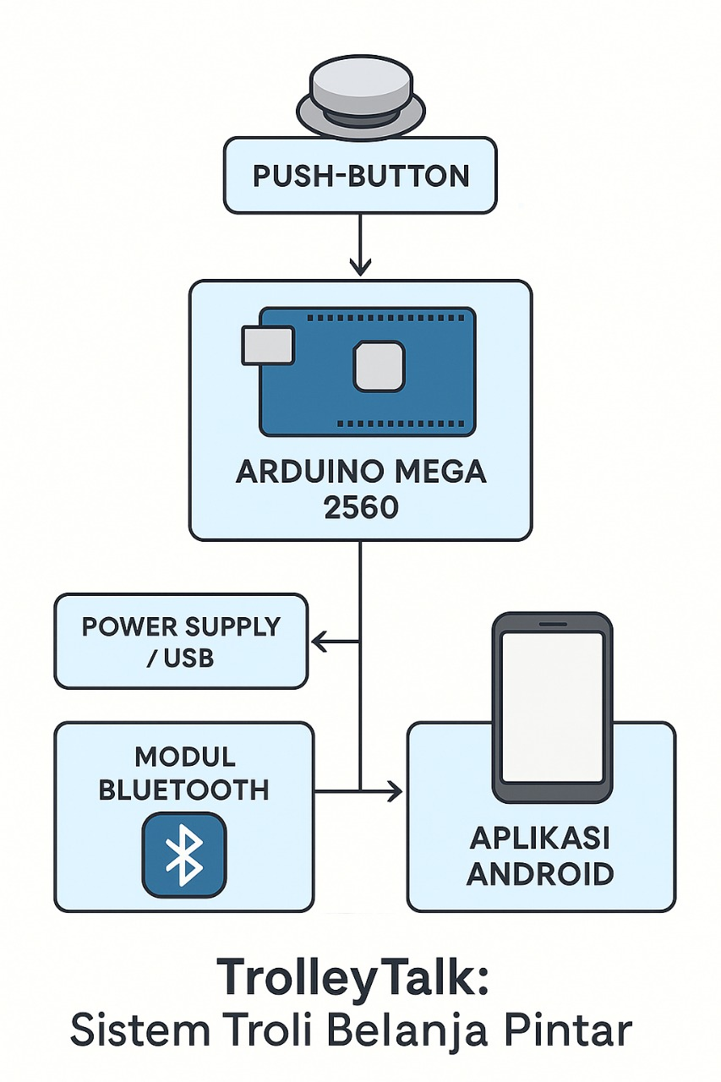
Blok Diagram

Slide 5
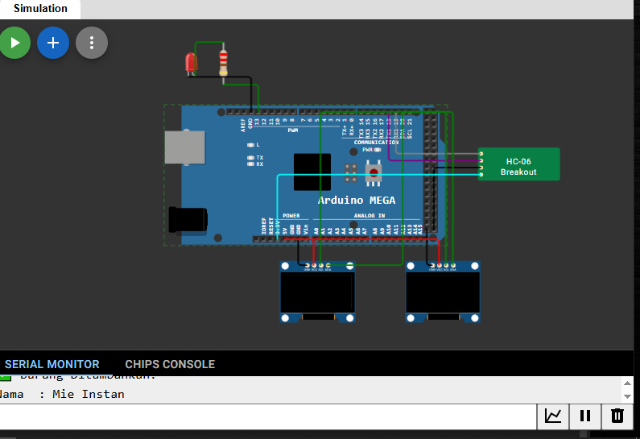
Rangkaian

Slide 6
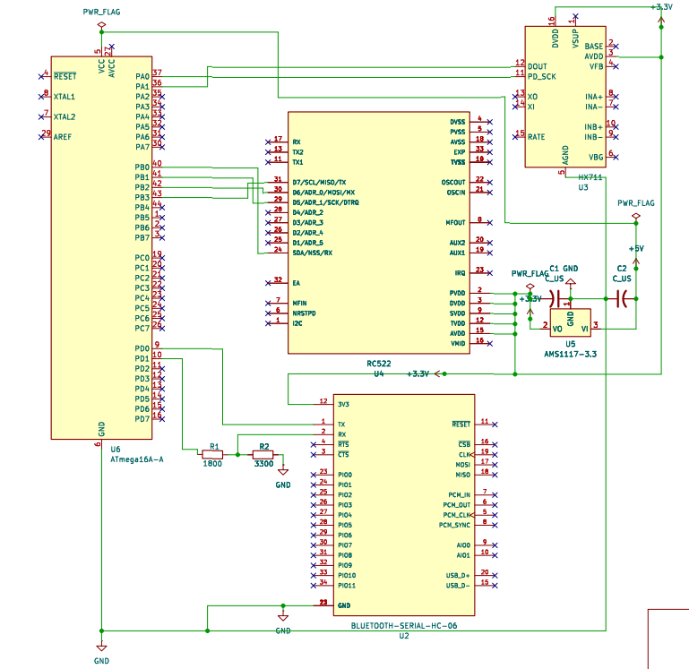
SCHEMATIC

Slide 7

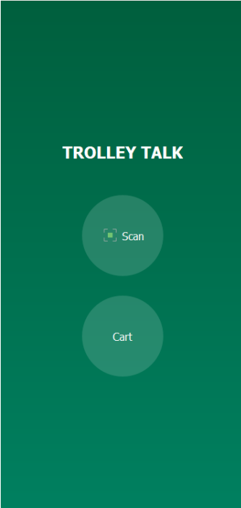
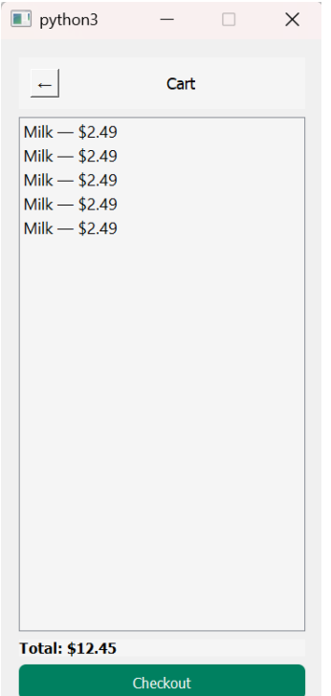
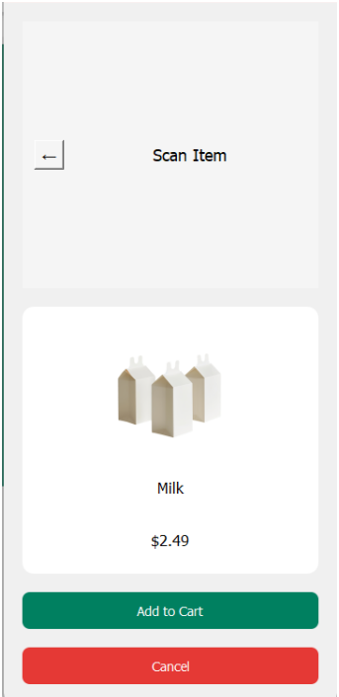
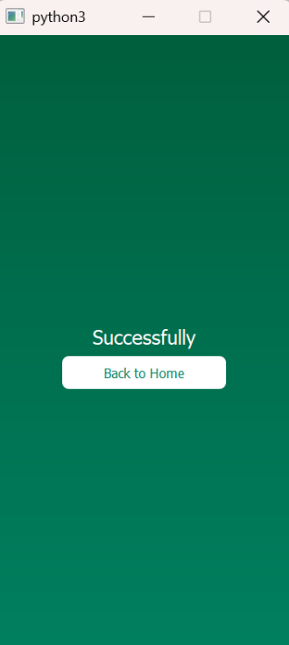
Tampilan Gui

Slide 8
Thanks!

